Slide 1
Introduction to JSP
Liu Haibin
26-11-08

Slide 2
Overview
Introduction
A JSP case
JSP vs ASP

Slide 3
What is JSP technology?
JavaServer Pages (JSP) technology provides a simplified, fast way to create web pages that display dynamically-generated content. The JSP specification, developed through an industry-wide initiative led by Sun Microsystems in June, 1999, defines the interaction between the server and the JSP page, and describes the format and syntax of the page. Sun has made the JSP specification freely available to the development community, with the goal that every Web server and application server will support the JSP interface. JSP pages share the "Write Once, Run Anywhere" characteristics of Java technology. JSP technology is a key component in the Java 2 Platform, Enterprise Edition, Sun's highly scalable architecture for enterprise applications.

Slide 4
What is a JSP page?
A JSP page is a page created by the web developer that includes JSP technology-specific and custom tags, in combination with other static (HTML or XML) tags. A JSP page has the extension .jsp or .jspx; this signals to the web server that the JSP engine will process elements on this page. Using the web.xml deployment descriptor, additional extensions can be associated with the JSP engine.

Slide 5
A simple JSP page
<%@ page language=“java”%>
<%@ page contentType="text/html; charset=ISO-8859-1"%>
<html>
<head>
<title>A simple case</title>
</head>
<body bgcolor="#FFFFFF" text="#000000">
<% String temp="the time now is:";%>
<%=temp%>
<%=(new java.util.Date()).toString()%>
</body>
</html>

Slide 6
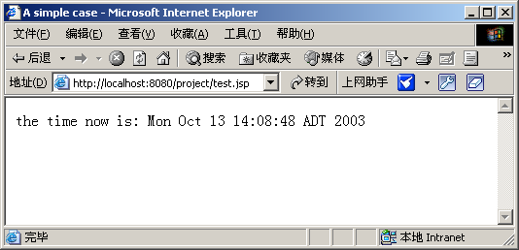
Output screen

Slide 7
JSP’s implementation
request
JDK
*.jsp
jsp parser
*.java
*.class
implementation
response

Slide 8
Overview
Introduction
A JSP case
JSP vs ASP

Slide 9
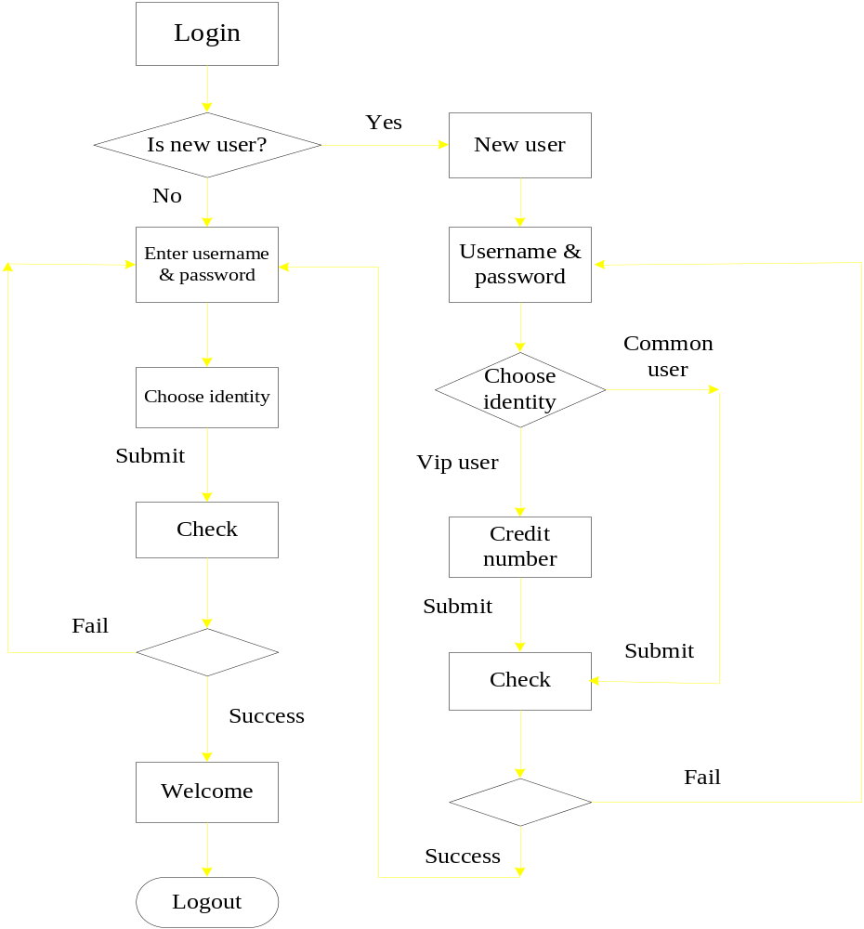
Flow chart

Slide 10
Overview
Introduction
A JSP case
JSP vs ASP

Slide 11
JSP vs ASP
JSP and ASP have some basic concepts in common.
1) They both make use of simple sever-side scripting to provide access to Web server information and functionality.
2) They both have similar styles of delimiting this scripting from a page's content.

Slide 12
Because it uses ActiveX controls for its components, ASP technology is basically restricted to Microsoft Windows-based platforms. Offered primarily as a feature of Microsoft IIS, ASP technology does not work easily on a broader range of Web servers because ActiveX objects are platform specific.
JSP technology adheres to the “Write Once, Run Anywhere” philosophy of the Java architecture. Instead of being tied to a single platform or vendor, JSP technology can run on any Web server and is supported by a wide variety of tools from multiple vendors.

Slide 13
JSP technology uses the Java language for scripting,
while ASP pages use Microsoft VBScript or JScript.
The Java language is a mature, powerful, and scalable
programming language that provides many benefits over
the Basic-based scripting languages.
The Java language makes the developer’s job easier in
other ways as well. The Java language also helps in the
area of memory management by providing protection
against memory leaks and hard-to-find pointer bugs
that can slow application deployment. Plus, JSP
provides the robust exception handling necessary for
real-world applications.

Slide 14
ASP Technology JSP Technology
Web Server | Microsoft IIS or Personal Web Server | Any web server, including Apache, Netscape, IIS, Websphere, and Weblogic
Platforms | Microsoft Windows (Accessing other platforms requires third-party ASP porting products.) | Most popular platforms, including the Solaris™ Operating Environment, Microsoft Windows, Mac OS, Linux, and other UNIX® platform implementations
Reusable, Cross-Platform Components | No | JavaBeans, Enterprise JavaBeans, custom JSP tags
Security Against System Crashes | No | Yes
Memory Leak Protection | No | Yes
Scripting Language | VBScript, JavaScript | Java
Customizable Tags | No | Yes

Slide 15
Five drawbacks
Only people who are very familiar with JAVA can use JSP pretty well.
JSP program is relatively difficult to debug.
Database connection is not very easy. Many codes are needed.
It is hard to choose proper servlet engine.
There are some other problems during JSP programming. The author of “Java servlet programming” wrote an interesting paper to compare JSP with other substituted tools. Please refer to:
http://www.servlets.com/soapbox/problems-jsp.html

Slide 16
Summary
I like HTML.
+
I’m crazy about Java.
≡
I love JSP!

Slide 17
Reference
http://java.sun.com/products/jsp/ ---JSP official website
http://www.indiawebdevelopers.com/technology/java/jspvsasp.asp ---JSP vs ASP
Comparing JavaServer Pages™ Technology and Microsoft Active Server Pages--An Analysis of Functionality
http://www.apl.jhu.edu/~hall/java/Servlet-Tutorial/ ---A Tutorial on Java Servlets and Java Server Pages

Slide 18
Thank you
for your attention!

